Slide 1
Streamfeeder
https://github.com/cahillsf/streamfeeder

Slide 2
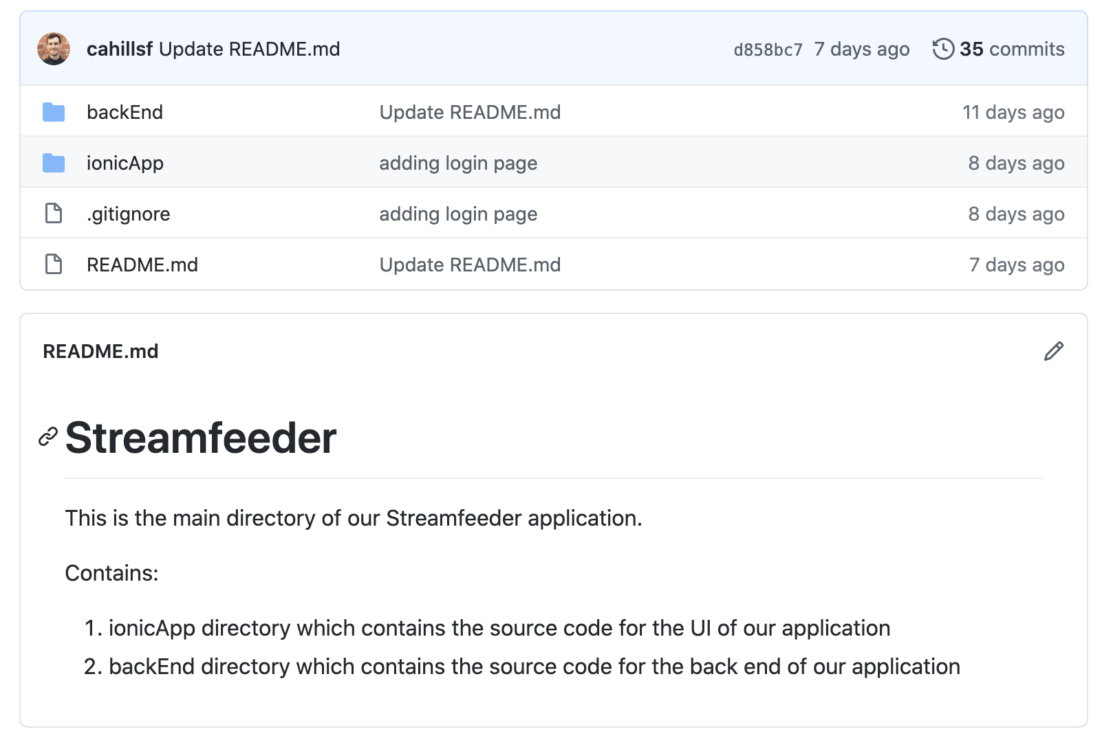
Repository Structure

Slide 3
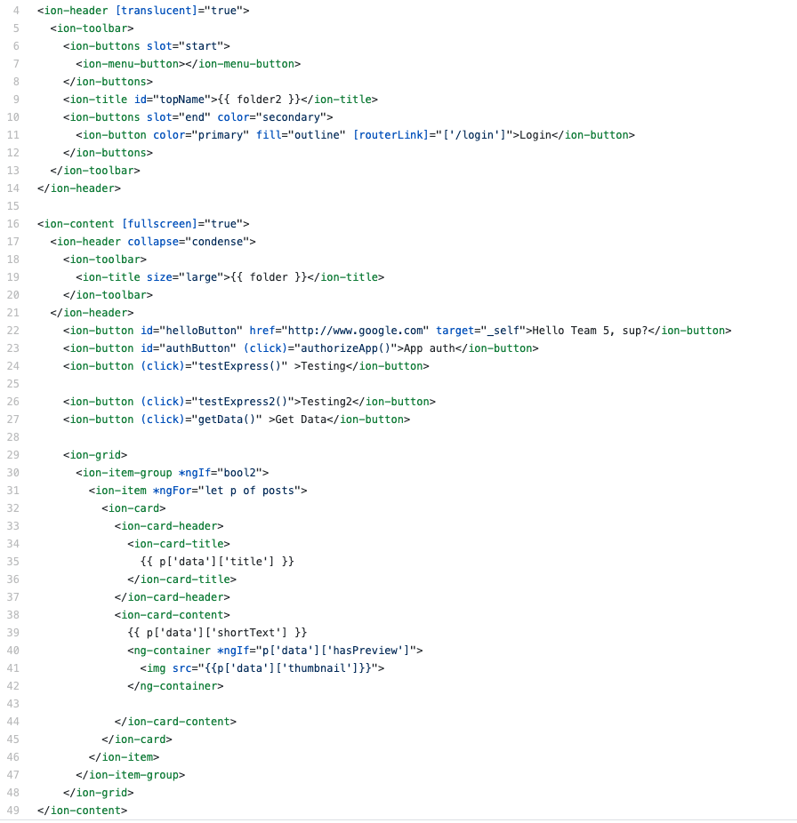
04.04 Intuitive landing page not requiring user login – HTML template

Slide 4
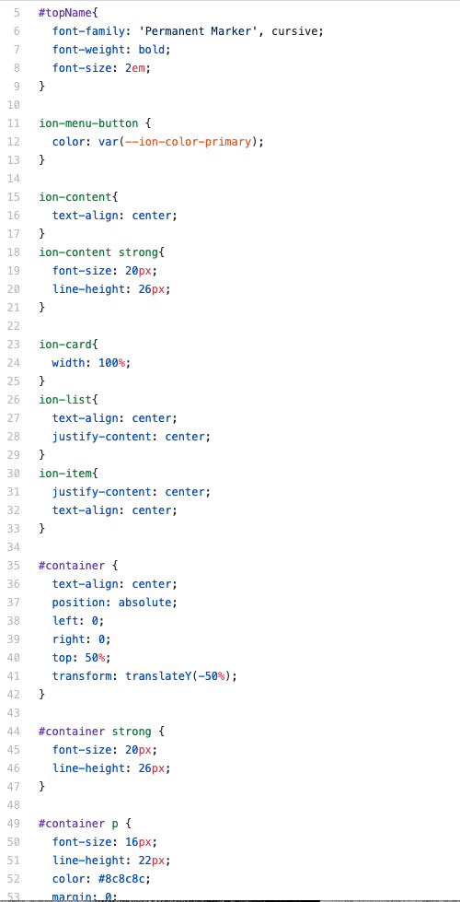
04.04 Intuitive landing page not requiring user login – SCSS styling

Slide 5
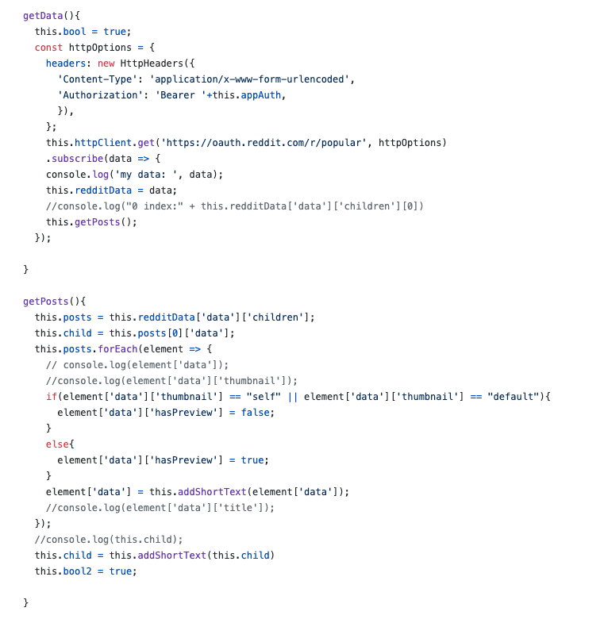
04.04 Intuitive landing page not requiring user login – Typescript functions pulling dynamic content via Reddit API integration

Slide 6
Build and Deploy In Dev Environment
Node.js is required (download LTS version here https://nodejs.org/en/)
Ionic is required (run this shell command “npm install -g @ionic/cli”)
Clone the project repository
cd into ionicApp directory
Install required node packages (run shell command “npm install”)
Launch dev server -> (run shell command ”ionic start”)
This command will open a tab in your default web browser to http://localhost:8100 where the development server is running

